Slide 1
Statistics
Lecture 01:
What is data science?
Oops, I mean, statistics.
Anirudh Wodeyar

Slide 2

Using Data Science to judge a serial killer
Harold Shipman: Britain’s most prolific murderer
Family doctor who killed ??? elderly patients

Slide 3
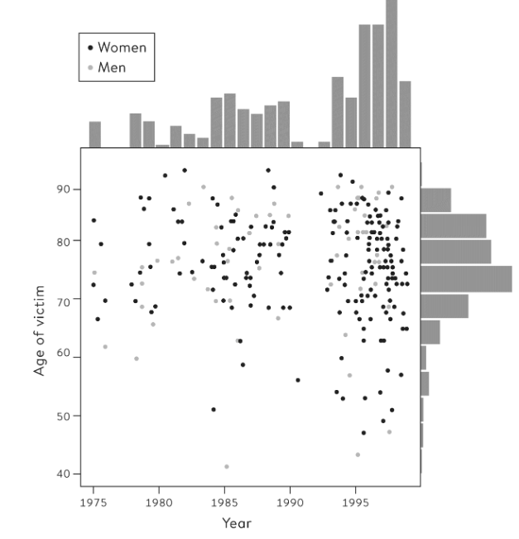

Using Data Science to judge a serial killer

Slide 4
Using Data Science to judge a serial killer
What do we know about him?
Family doctor
Between 1975 to 1998 killed 215 of his elderly patients with an opiate overdose (maybe 45 more)
Said nothing at his trial
Caught after he tried to forge a will of a patient
Notes:
He’d been editing the medical details of patients he killed to make them seem sicker than they were, after having killed them. He was smart but there were timestamps that made it clear he’d edited it after they were dead repeatedly.

Slide 5
Using Data Science to judge a serial killer
What were the characteristics of the people he murdered and when did they die?
Art of Statistics, David Spiegelhalter
Notes:
What can we say from this plot?
First what is this plot telling us.
Whats on the y-axis (what IS the y-axis?). Whats on the x-axis.
What is each dot?
Whats on the top and the right sides?
More women than men.
Whats the little gap mean? Shipman had started working with some colleagues so he didn’t’ want to look suspicious.
Did he only murder elderly people?

Slide 6
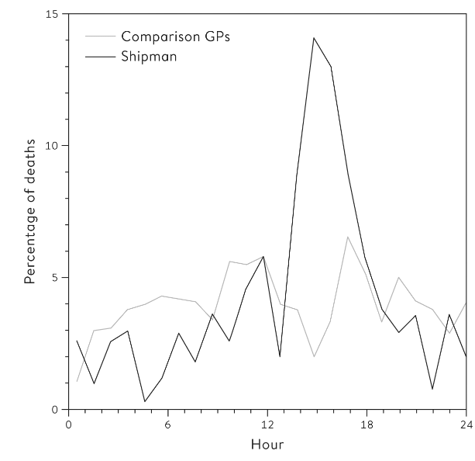
Using Data Science to judge a serial killer
How did Shipman commit his murders?
Art of Statistics, David Spiegelhalter
Notes:
Why did they all seem to die around 2- 4 pm? House calls.

Slide 7
Using Data Science to judge a serial killer

Slide 8
Using Data Science to judge a serial killer
Dame Janet Smith: “I still do feel it was unspeakably dreadful, just unspeakable and unthinkable and unimaginable that he should be going about day after day pretending to be this wonderfully caring doctor and having with him in his bag his lethal weapon … which he would just take out in the most matter-of-fact way.”
Art of Statistics, David Spiegelhalter
Notes:
Janet smith chaired the public inquiry.

Slide 9
One branch of data science: Forensic statistics
No models, no fancy math, just looking at data carefully, again, and again
After critically assessing data, we need to plot it as well: how do we decide how/when to do that?
Could also have used formal statistical analysis, but how?

Slide 10
The World Can Be Quantified
To understand the nature of Shipman’s murders, we abstracted out the details, we turned people into numbers, each person into a dot (slightly terrifying, but in the end, for this purpose, useful).
Definition
Data science and statistics is the process of abstracting the world into numbers and then finding the patterns across those numbers using critical reasoning and mathematical tools.

Slide 11
The World Can Be Quantified
As an example, consider the question:
“Are there more computing machines in PHS1-B compared to PHS1-C?”
How do we go about answering this question?
First, we need to answer what is a computing machine? Is your phone a computer? A calculator?
Notes:
You can already see how there is a weird thresholding happening here that is confusing. Because what about tablets? Some people will have tablets, are those not considered computing machines? This is something we always have to consider when looking at data, whatever definition we impose on the world to quantize it, we have missed something else.

Slide 12
The World Can Be Quantified
Now, how can we quickly assess how many computers are in this building?
How many lab rooms on this floor?
Each student has a laptop. How many lecture halls?
How many students in the study hall on the ground floor?
How can we verify this?
Notes:
We just ran a simulation study. You could turn what we just did into an algorithm with specific parameters to get estimates for the number of computing machines over and over again.

Slide 13
The World Can Be Quantified
Quantification can be messy.
Quantification can yield inaccurate numbers relative to our intended goals.
What if we wanted to know how much an injection hurt and used a survey from 0 to 10?
Notes:
I was asked to rate on 0 – 10 how much an injection hurt.
What did 0 mean? I didn’t feel it? That seems to suggest something is wrong with me. Or did it mean, I enjoyed it so much I want you to keep doing it to me again and again and again…
What did 10 mean? Could an injection have hurt as much as a serious life-threatening injury?

Slide 14
The World Can Be Quantified… but this needn’t be meaningful
Data science and its older sibling - statistics - are always constructed based on judgements (e.g. what is a computing machine?).
Delusional to believe data is the real world.
But. We can still understand an approximated fact about the real world with data.
Sometimes, that fact can be extrapolated.

Slide 15
The World Can Be Quantified… but this needn’t be meaningful
Data has two main limitations:
1. Data is always an imperfect measure of what we are really interested in: so how can you improve the measure?
2. Anything we choose to measure will differ from place to place, person to person and time to time: so how can you tame or at least understand that variability?
Answering these two questions well and in a meaningful manner is the main goal of data science. How can we do that?
Notes:
Good question for a test.

Slide 16
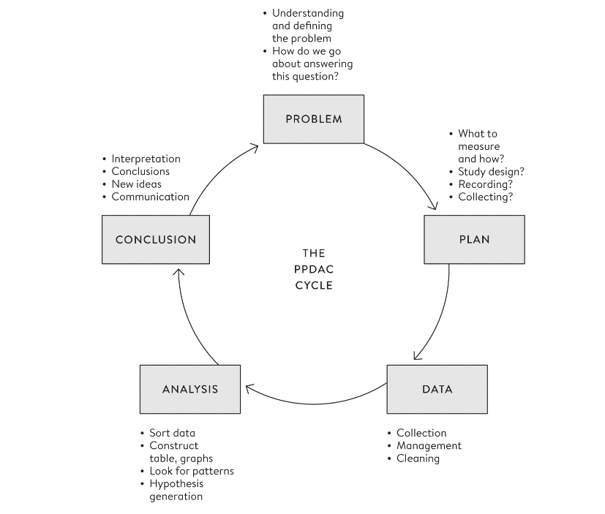
Notes:
We can use this architecture to understand the general life cycle of a data science problem.

Slide 17
What are you hoping to get from this class?

Slide 18
Class Goals
Achieve a basic level of data/stats literacy:
the ability to understand the principles behind learning from data,
carry out basic data analyses,
understand what are good and bad visualizations, &
critique the quality of claims made based on data.

Slide 19
Course organization

Slide 20
About me

Slide 21
About me

Slide 22
About me

Slide 23
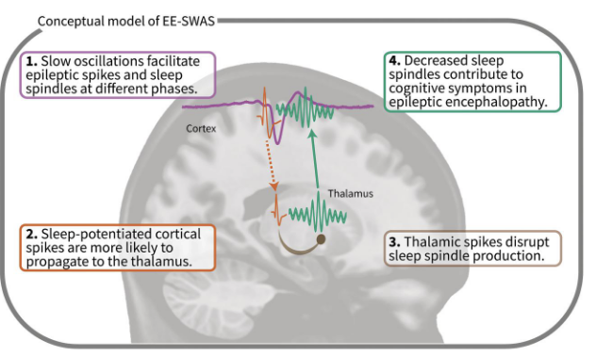
About me: Research
Love thinking about how statistics can help us understand the brain and change it.

Slide 24
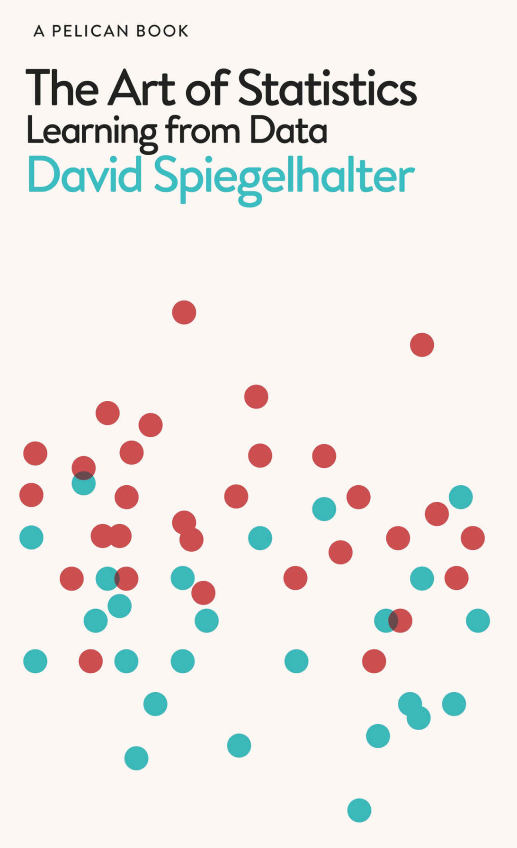
Textbook
Art of Statistics by David Spiegelhalter

Slide 25
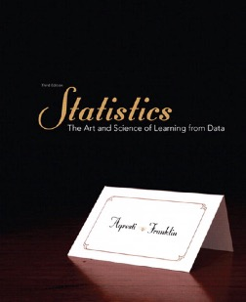
Support Resource
Statistics
The Art and Science of Learning from Data
Agresti and Franklin
3rd Edition

Slide 26
Instruction format
Lectures (Concept & Live analysis)
Labs
Read chapters

Slide 27

Organization of Lectures
Introduce concepts
Live analysis: examples of these concepts coded up in Python

Slide 28

Labs
Processing data
Analyzing data
Visualizing data

Slide 29
Organization of Tutorials
Tutorials will be run in one room (hopefully) and primarily guided by Cedric.
A few TAs will provide support.
Tutorials will comprise of practicing problems based on lectures and completing your assignments.

Slide 30
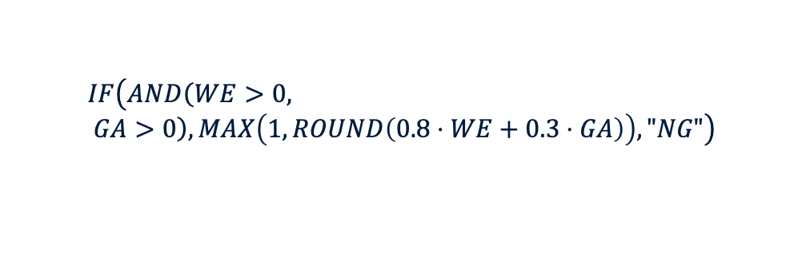
Grading
Assessment component | Form and extent (length) | Grading scheme | Form of the Resit
Written exam (mandatory) | 2 hours | Points per exam question depend on difficulty and expected length. | Regular resit in the ongoing academic year
Group assignment | One group assignment where you run an experiment and do some data analysis/visualization. | Rubrics based | There is limited resit opportunity for this component (see syllabus).
The following components will be examined, and will count towards the final grade of the course:
Written Exam (WE), graded 0.0-10.0, weight 80% (mandatory)
Group Assignment (GA), weight 20%.
The final grade is calculated as:
$$IF\left(AND\left(WE>0, GA>0\right),\operatorname{MAX}\left(1, ROUND\left(0.8⋅WE+0.3⋅GA\right)\right),"NG"\right)$$

Slide 31
Exam
Closed book exam
Duration: 120 minutes, without breaks.
Allowed aids: Pen, calculator from DACS allowed calculator list.
Mock exam will be posted on CANVAS (time TBD)
Multiple Choice: related to discussed concepts
Statements: true/false + explanation
Data analysis problems: describe the steps to take

Slide 32

Communication
Lectures
Labs
Canvas discussion board
Please, do NOT send us e-mails with questions

Slide 33
Course Overview

Slide 34
Tentative Schedule
Understanding nature of data and what is done with it.
Basic data summaries for
Categorical data
Continuous data
How to collect data? What are we usually trying to say with data? <causality>
What is probability really?
How does it get used to understand the structure of data?
How can we make any decisions from data?
Notes:
Summaries of Data [data analysis with Jerry in year 3]

Slide 35
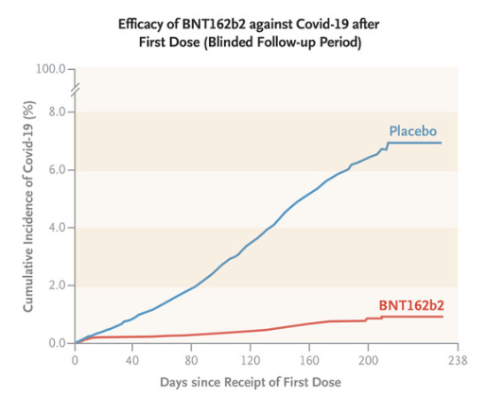
What is statistics good for?
Vaccine and drug testing
How can we know whether a given vaccine or drug actually improves human health?

Slide 36

What is statistics good for?
Helping people who have lost the ability to speak to be able to speak!
This is a collaboration between statistics, and its sibling fields signal processing, machine learning and optimization.

Slide 37
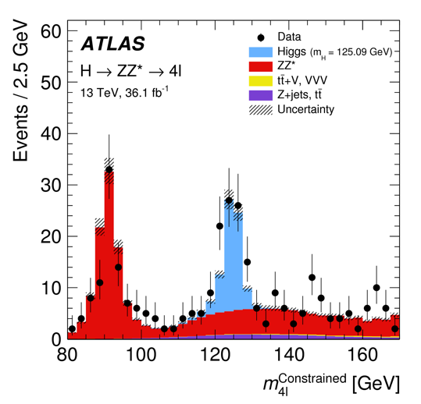
What is statistics good for?
Identifying the fundamental particles of our world.
The Higgs Boson’s presence was confirmed with a statistical test.

Slide 38
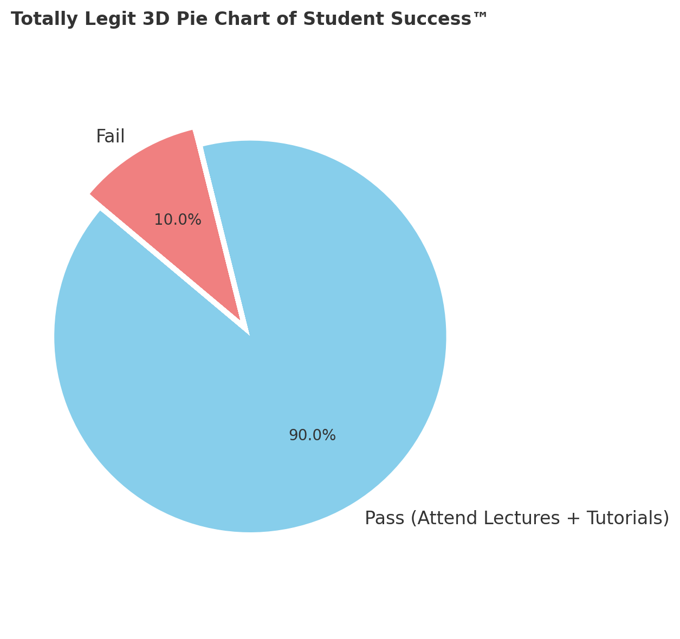
What is statistics good for?

Slide 39
Studying categorical data and percentages
What happened to children having heart surgery in Bristol between 1984 and 1995?
Joshua was 16 months old and needed a critical heart surgery.
He was at Bristol Royal Infirmary where there were stories about poor surgical survival rates, but his parents didn’t know.
There was even a last-minute meeting to consider canceling his surgery but parents weren’t informed.
Joshua passed away on the operating table.
Our problem: Was this to be expected?

Slide 40
Notes:
Problem: Was it expected that children were unlikely to survive surgeries at Bristol?
Plan: Compare survival rates at Bristol with survival rates around the country.
Data: Get data about survival from hospitals around the country and assess survival.
Analysis and Inference: Estimate average survival rates for all hospitals and compare that to the survival rate in Bristol.
Conclusion: ?

Slide 41
Data: Defining the variables.
We have two variables (what’s that?): child and death.
How should we define them?
DS and team defined child as: “anyone under 16 years old”.
How should we define survival? Is it only if the child survived the operation or if they survived enough to suggest the surgery was successful?
DS and team defined an unsuccessful surgery as “death within 1 month”.
Definition
A variable is any measurement that can take on different values in different circumstances but is inter-related by the fact that it is the same type of measurement every time.
Notes:
When do these measures fail? Remember all definitions exclude and our conclusions may not want that exclusion.
Brain death not inckuded
What about kids who just turned 16?

Slide 42
Analysis: What were surgical outcome rates?
Bringing data together from many sources can be hard.
After integrating data across different sources:
Average risk across other hospitals suggested only 32 deaths should have happened for the number of surgeries performed.
There were, instead, 62 deaths at Bristol. 30 more than expected.
Notes:
How was the average risk calculated? Perhaps we can do this in the lab.
Spell out what the data looks like (vector) and how we calculate the above (sum/mean).

Slide 43
Conclusion: Bristol had killer surgeons.
Given how many more deaths were happening than expected, we can say with some certainty that Bristol did not have a good surgery department.
BUT. There’s always exceptions.
This depends on the assumption that the cases that came through Bristol were the same as cases that came through other hospitals. What if the sicker kids tended to come to Bristol?
We know this was not the case. However, this illustrates the cycle of PPDAC: We are now back at the Problem stage.
Notes:
This conclusion lead back to the problem and led to people finding ways to collect data more accurately and set up analyses that forced hospitals to become more accountable for their outcomes.

Slide 44
Categorical Data
Definition
Binary data is data that records whether individual events have happened or not (e.g. death vs no death), as these situations can take on only one of two values, they are binary (0/1). This is one form of categorical data.
For example: Assuming 100 children (<16 years old) passed through the Royal Bristol Infirmary, for each child we can mark them as 0 or 1 defining whether or not they passed away after surgery.

Slide 45
Categorical Data
Definition
Binary data can be summarized by a percentage or by two numbers: the total number of possible events and the sum of 1s (or equivalently the number of 0s).
For example: For the 100 children, we can describe the summary as 95 children survived out of 100 children or that there was a survival rate of 95%.
Note that already we have abstracted away a LOT of detail. That detail is usually what brings us back to the first P of PPDAC.

Slide 46
Categorical Data
Definition
Categorical variables are measurements that can take on two or more categories (binary data is a form of categorical data).
Unordered categories: Person’s country of origin, color of a car or the hospital where an operation takes place (we can abstract them by assigning a random integer for each individual category).
Ordered categories: Rank of military personnel, grade that you receive.
Numbers that have been grouped: Levels of obesity (defined as ranges of BMI) or whether you are a child or an adult.
Notes:
Should be careful when multiple categories exist that we don’t take a mean over them.

Slide 47
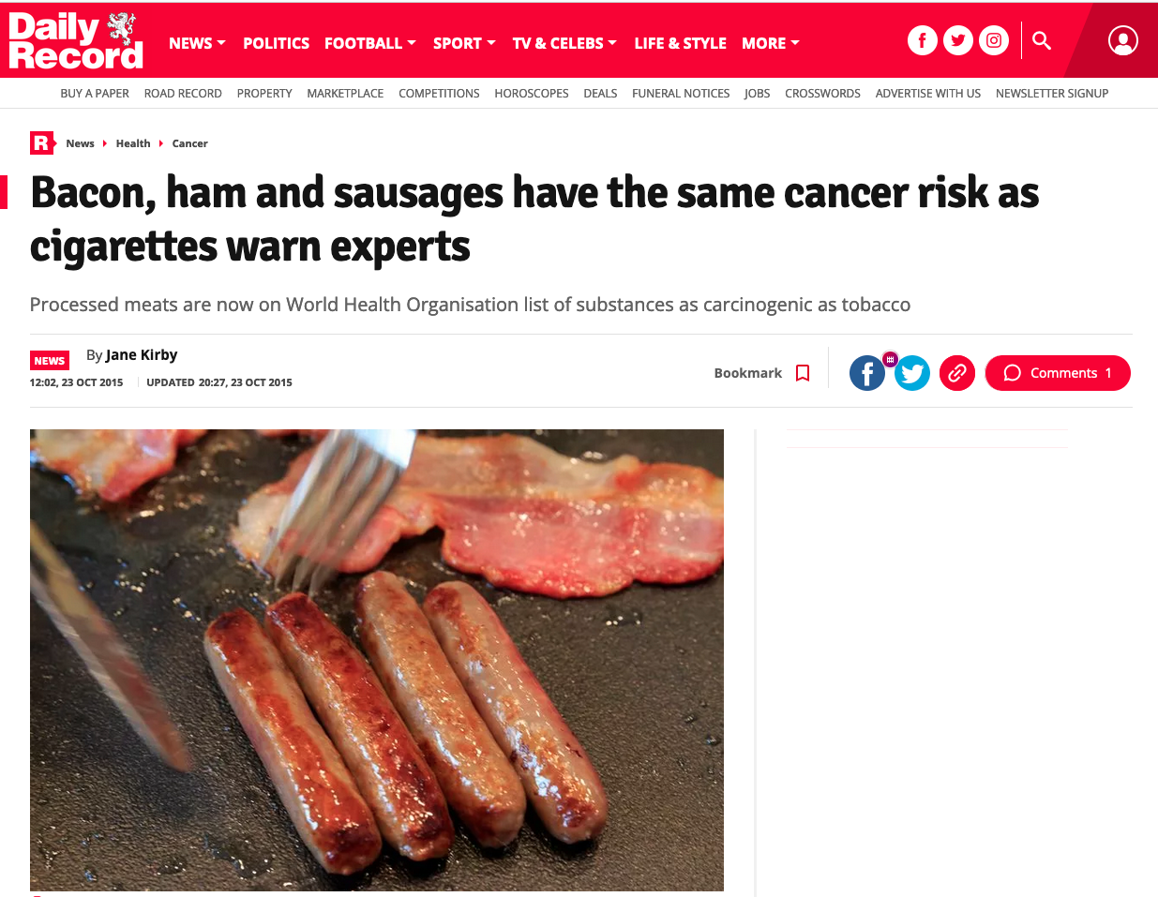
Associations of Categorical Variables
Notes:
We’ve so far been considering single proportions, what if we wanted to compare a pair? When would that happen?

Slide 48
Associations of Categorical Variables
Came from the International Agency for Research in Cancer putting red meat in same category as cigarettes and asbestos (a ‘Group 1 carcinogen’)
“50g of processed meat associated with increased risk of bowel cancer of 18%”
What does that mean?
Notes:
IARC

Slide 49
Associations of Categorical Variables
The ”18%” increase is a relative risk.
What is the absolute risk? That is, how often do people eating meat get bowel cancer?
~7.1 out of 100 people get bowel cancer if they eat red meat (p=7.1%).
~6 out of 100 people get bowel cancer if they don’t eat red meat (q = 6.1%).
(7.1/6) * 100 = 118.33% => 18% above the expected amount.
Definition
Relative risk: If the absolute risk among people who are exposed to something of interest is p%, and the absolute risk among people who are not exposed is q%, then the relative risk is p/q.
Notes:
The mistake in communication that happened was framing a relative risk as an absolute risk (cancer risk increased by 18%)

Slide 50
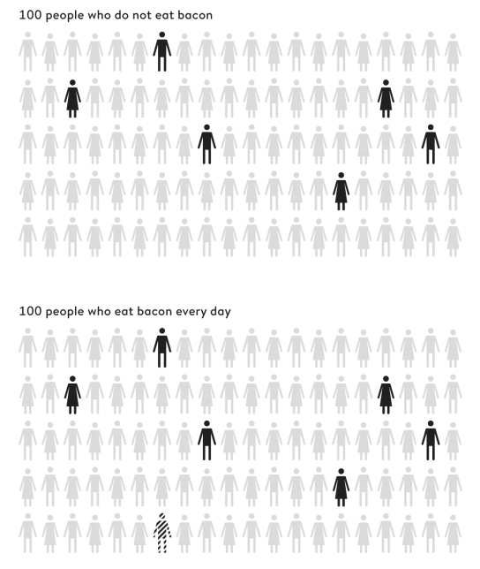
Associations of Categorical Variables
But the expected frequencies (6/100 and 7.1/100) told us MUCH more.
There was more clarity about the risk from the expected frequencies.
Definition
Expected frequencies are the numbers of events expected to occur in the future, according to an assumed probability model.
Notes:
Icon array. More clear way of representing risk using expected frequencies.

Slide 51
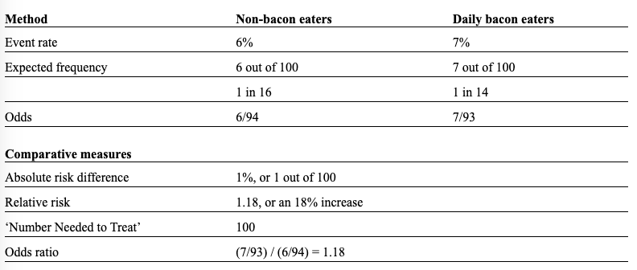
Associations of Categorical Variables
Notes:
The ‘Number Needed to Treat’ is the number of people needing to eat a bacon sandwich every day of their lives, in order to expect one extra case of bowel cancer

Slide 52
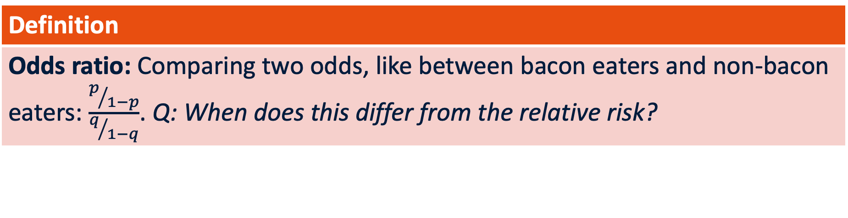
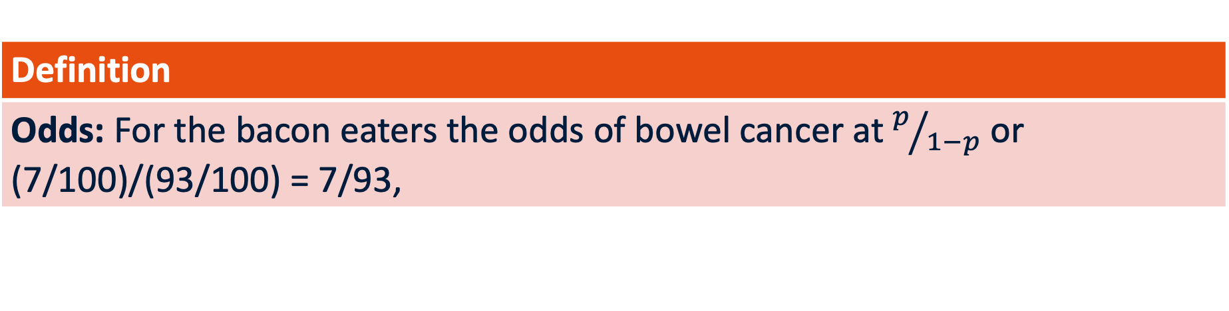
Associations of Categorical Variables
Definition
Odds: For the bacon eaters the odds of bowel cancer at $p/{1−p}$ or (7/100)/(93/100) = 7/93,
Definition
Odds ratio: Comparing two odds, like between bacon eaters and non-bacon eaters: $\frac{p/{1−p}}{q/{1−q}}$. Q: When does this differ from the relative risk?
Notes:
The odds ratio is saying how much does the probability of,, for example, getting bowel cancer change.

Slide 53
Contingency Table
 | Cancer | No Cancer
No Red Meat | 6 | 94 | 100
Odds are (6/100)/(94/100) = 0.064 i.e. a ratio of expected frequencies.
If we pretend that Cancer is Heads and No Cancer is Tails, we are checking how often we get cancer with the odds.
We’re unlikely to get heads (cancer) because of 6% expected frequency.
Notes:
The idea of the odds is that, if I were to flip an imaginary coin with the probabilities of the occurrences we see in the data, then how often do I get head i.e. cancer?
Coin has 50-50 odds. Or 0.5 odds.

Slide 54
Contingency Table
 | Cancer | No Cancer
Red Meat | 7 | 93 | 100
No Red Meat | 6 | 94 | 100
 | 13 | 187 | 200
Odds ratios tell us about how expected frequencies across one variable change due to a second variable.
Notes:
The idea of the odds is that, if I were to flip an imaginary coin with the probabilities of the occurrences we see in the data, then how often do I get head i.e. cancer?

Slide 55
Contingency Table
 | Cancer | No Cancer
Red Meat | 7 | 93 | 100
No Red Meat | 6 | 94 | 100
 | 13 | 187 | 200
Contingency tables enable assessing whether there is an association between two categorical variables.
Notes:
Conditional and marginal.

Slide 56
Conditional and Marginal Proportions
What is the proportion of people getting cancer conditional on eating red meat?
7/100
What is the marginal proportion of people eating red meat?
100/200

Slide 57
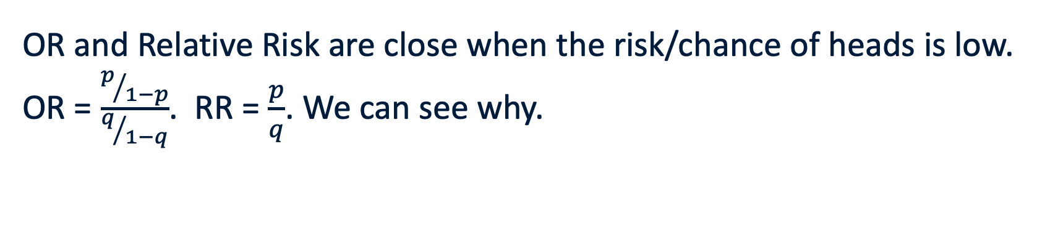
Odds Ratio (OR) vs Relative Risk
OR = 1 | Relative Risk = 1 | Implies that exposure doesn’t affect odds of outcome (e.g. cancer).
OR>1 | Relative Risk > 1 | Implies exposure is associated with increased odds of the outcome.
OR<1 | Relative Risk < 1 | Implies exposure associated with lower odds of outcome.
OR and Relative Risk are close when the risk/chance of heads is low.
OR = $\frac{p/{1−p}}{q/{1−q}}$. RR = $\frac{p}{q}$. We can see why.

Slide 58
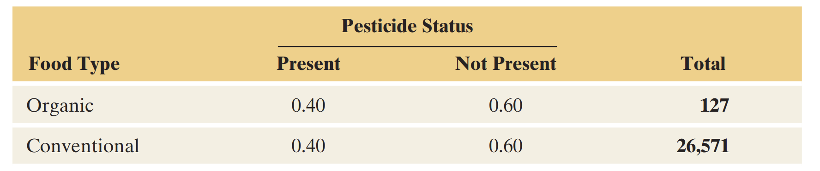
OR = 1
Notes:
No association here between whether or not there’s pesticides on vegetables as a function of whether it is organic or conventionally produced veggies.

Slide 59
Odds Ratio vs Relative Risk
 | Statins | No Statins
Muscle Pain | 87 | 85 | 172
No Muscle Pain | 13 | 15 | 28
 | 100 | 100 | 200
OR = ??, so odds are slightly higher, but:
Relative Risk = ??

Slide 60
Odds Ratio

Slide 61
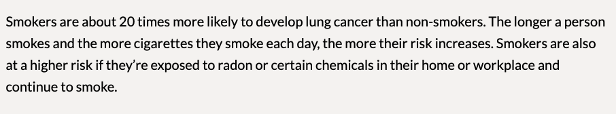
Odds Ratio (OR) vs Relative Risk
From cancer.ca:
What kind of comparison is this?

Slide 62
Odds Ratio (OR) vs Relative Risk

Slide 63
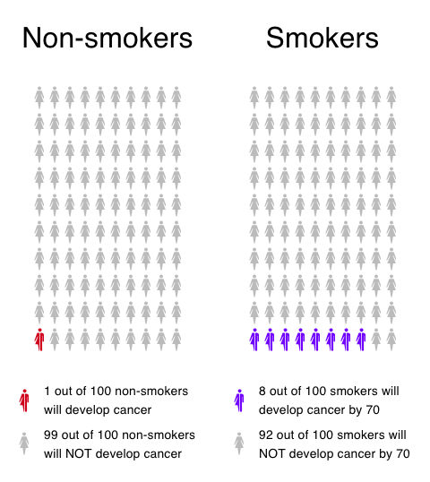
Odds Ratio (OR) vs Relative Risk
Calculate the odds ratio of smoking against non-smoking and relative risk for this case.
Notes:
When I flip a coin asking for heads, pretending that is cancer when smoking, how much more likely am I to get heads than tails in that case?

